Slide 1

Hybrid Cloud Solutions
Access your data from Everywhere with CP4D/Data Fabric & Virtualization
Benoit MAROLLEAU – Cloud/AI Architect Hybrid Cloud Solutions – IBM Client Engineering | EMEA
benoit.marolleau@fr.ibm.com
https://ibm.biz/bma-wiki

Slide 2
RetailOne Use case
Objectives
How a data fabric can help manipulate and filter data, and expose them to the appropriate target system?
Dispersed data sources :
Global Product Catalog / Prices / Product classification
CRM
E-Commerce : Orders
ERP per Store : Billing / Stocks/ Assortment …
ETL Simplification with Data consumption - Apache NIFI (ETL) or Salesforce

Slide 3
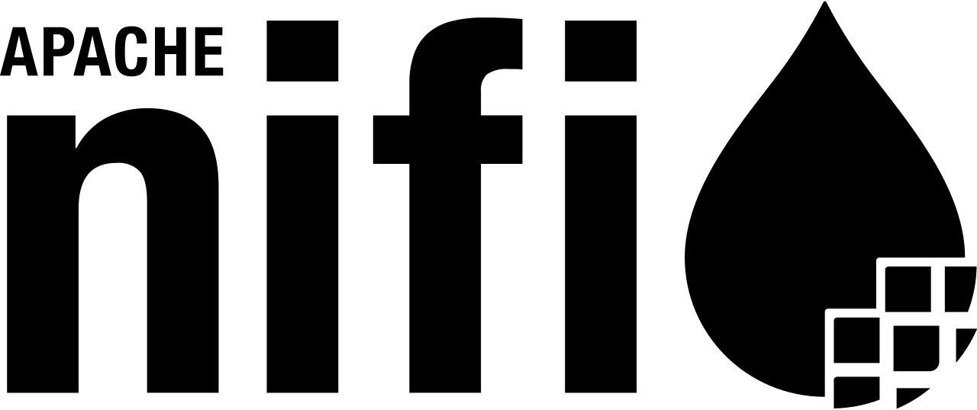

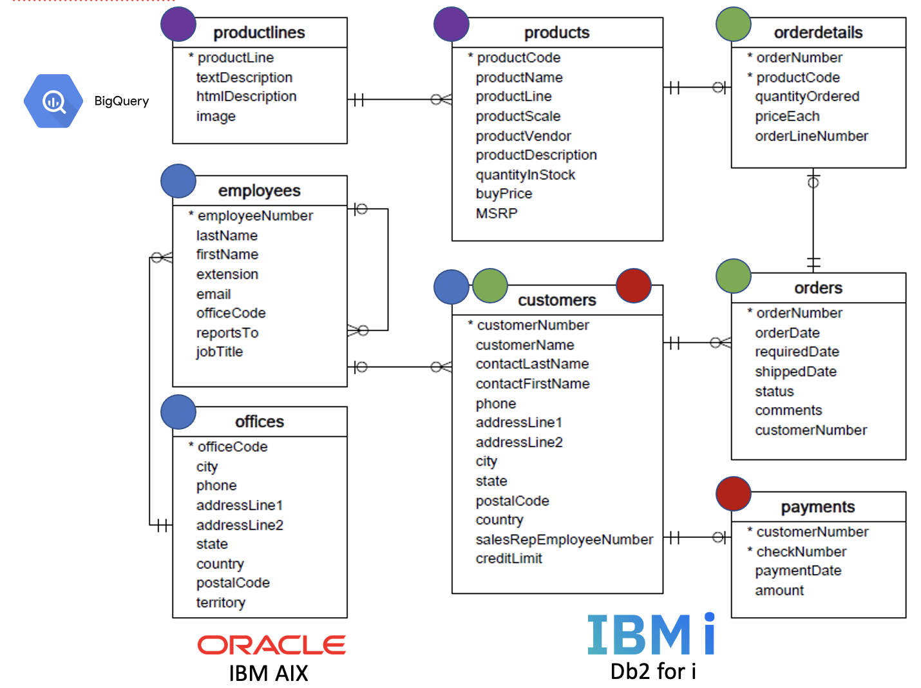
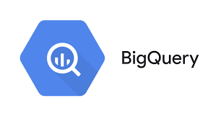
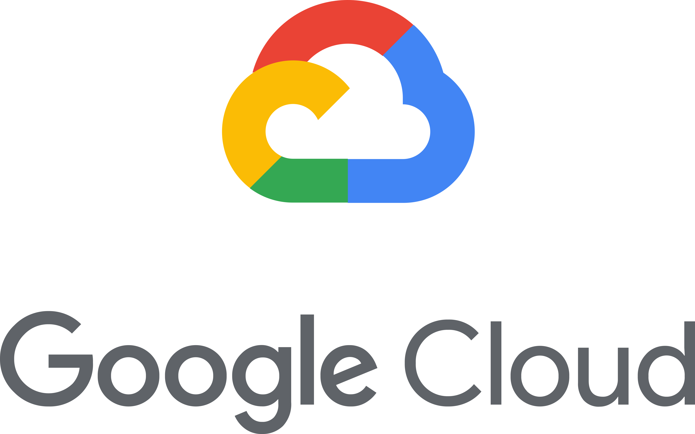

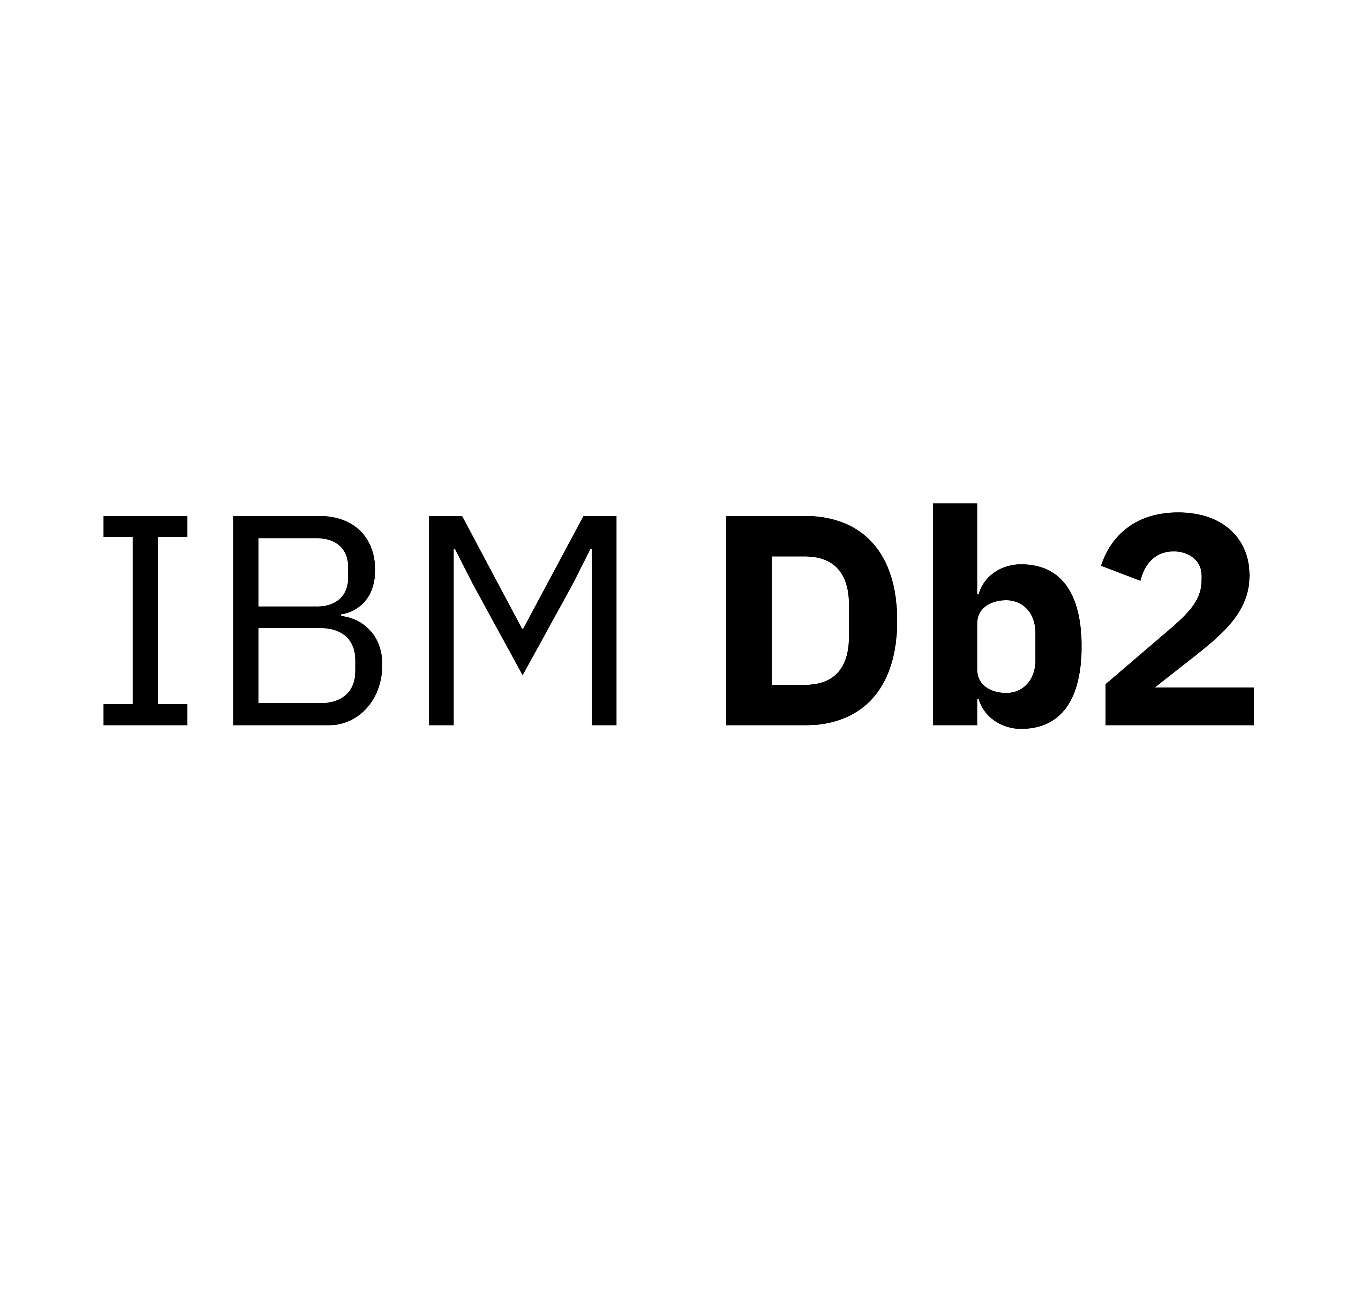
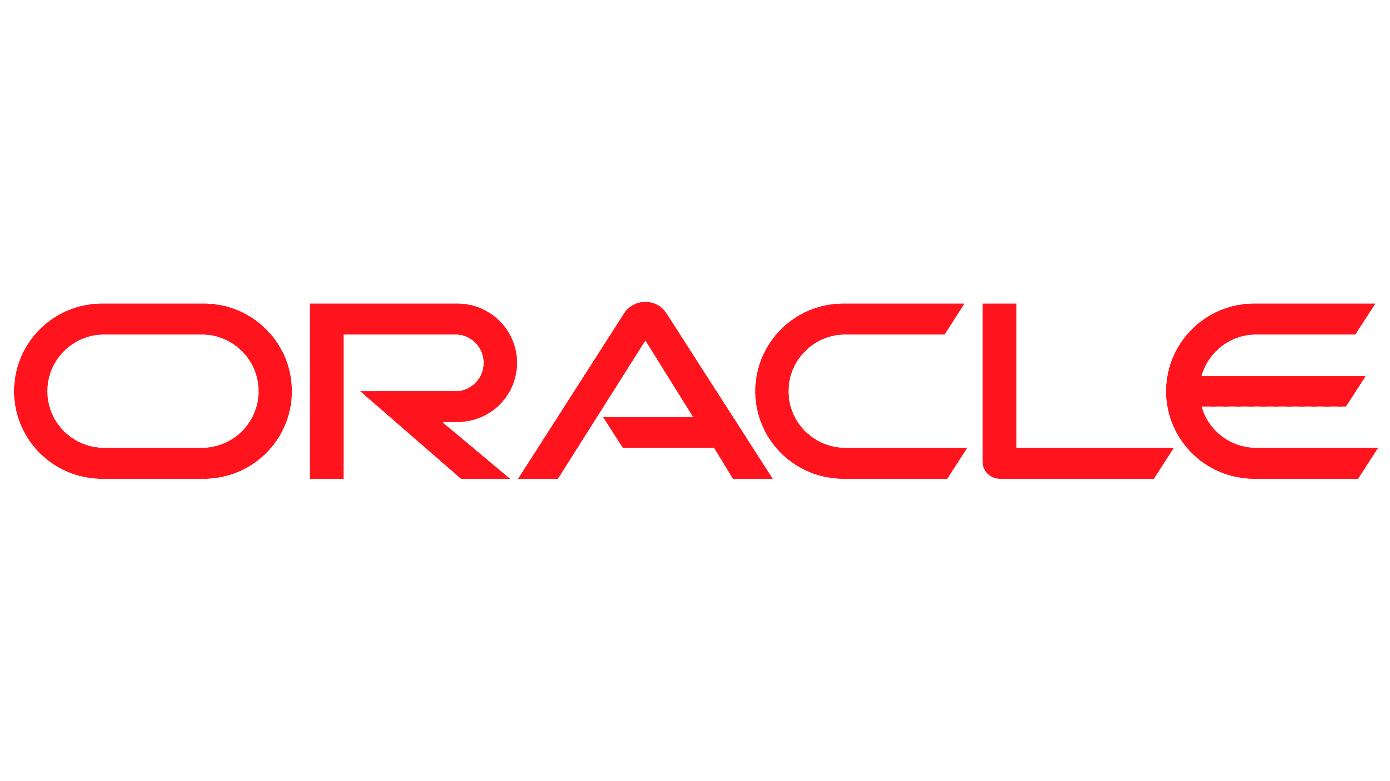
RetailOne Demo IBM Data Fabric pattern: Governed Data Virtualization
The ability to view, access, manipulate and analyze data without the need to know or understand its physical format or location, and without having to move or copy it.
ETL
Impact of modern Information Architecture
Analytics Tools
Portals
Web Services
Data fabric, on a cloud native architecture
Reduces data silos and provides a single view of trusted business data
Reduce data copies and movement
Enable self-service and data democratization
Centralized control and governance
Real-time sharing of data with business users
Operationalize AI with trust and transparency
Applications
Mobile Apps
Consumers
Data Collaboration
(Governed Metadata)
Consumer Layer
(Interface Provisioning)
Business Terms
Data Privacy &
Protection Rules
Lineage
Virtualization Layer
Virtualization
Platform
Caching &
Optimization
Connection Layer
(Adaptors)
Cloud Pak for Data
Schema Folding
Warehouses
(Per Store)
Data Sources
Products Catalog Prices / Product classification
Web
Services
Virtual Database
Cloud
ERP Billing / Stocks/ Assortment …
CRM
Client/ sales

Slide 4
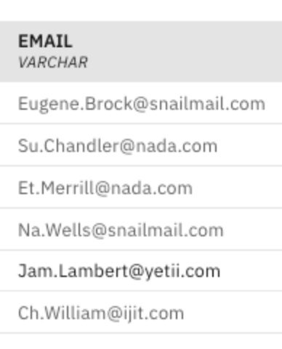
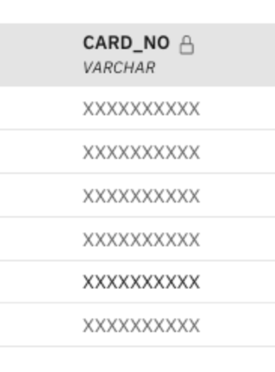
Integrated Governance
RetailOne Demo
The ability to classify, mask and protect sensitive data from a single pane of glass
Application
DV Publishes remote assets to WKC.
WKC Discovery performs classification, scoring, term association
DV retrieves Business Terms for the source tables to give the users a common understanding of the data.
DV obtains information about the policies it needs to enforce upon data access.
Business terms for source tables
3
Business Glossary
Catalog
DV Engine
Data Policy Service
4
Data Protection
1
Publish
2
Discovery
Data Virtualization
Watson Knowledge Catalog
Data Sources
Products
ERP
CRM

Slide 5

RetailOne Demo
Product Catalog / Prices / Product classification
CRM
E-Commerce : Orders
ERP per Store : Billing / Stocks/ Assortment …
IBM AIX
Db2 for i

Slide 6
RetailOne Demo IBM Data Fabric pattern: Governed Data Virtualization
Data consist of the following databases/schemas/tables:
Big Query - GCP
Products: stores a list of scale model cars.
ProductLines: stores a list of product line categories.
Db2 for i - On Prems :
Customers: stores customer’s data.
Orders: stores sales orders placed by customers.
OrderDetails: stores sales order line items for each sales order.
Payments: stores payments made by customers based on their accounts.
Oracle AIX - On prems :
Employees: stores all employee information as well as the organization structure such as who reports to whom.
Offices: stores sales office data.

Slide 7
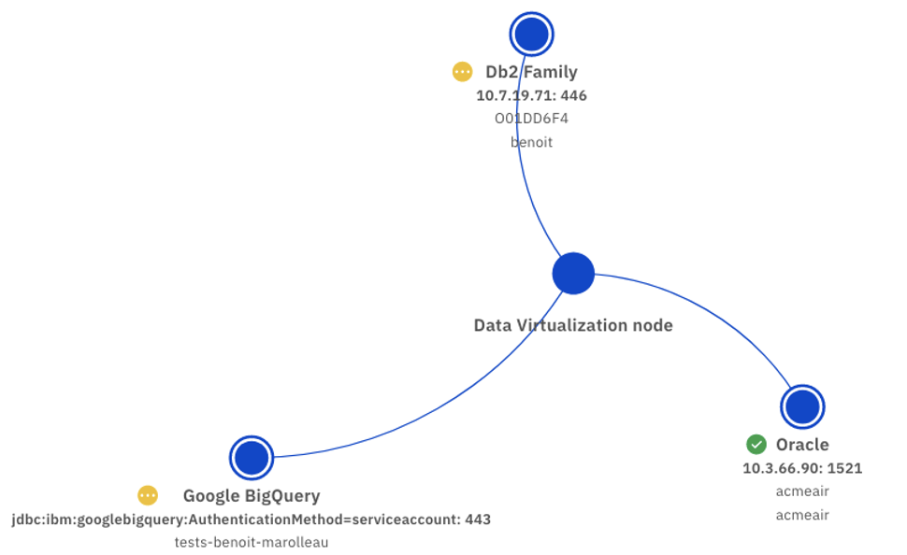
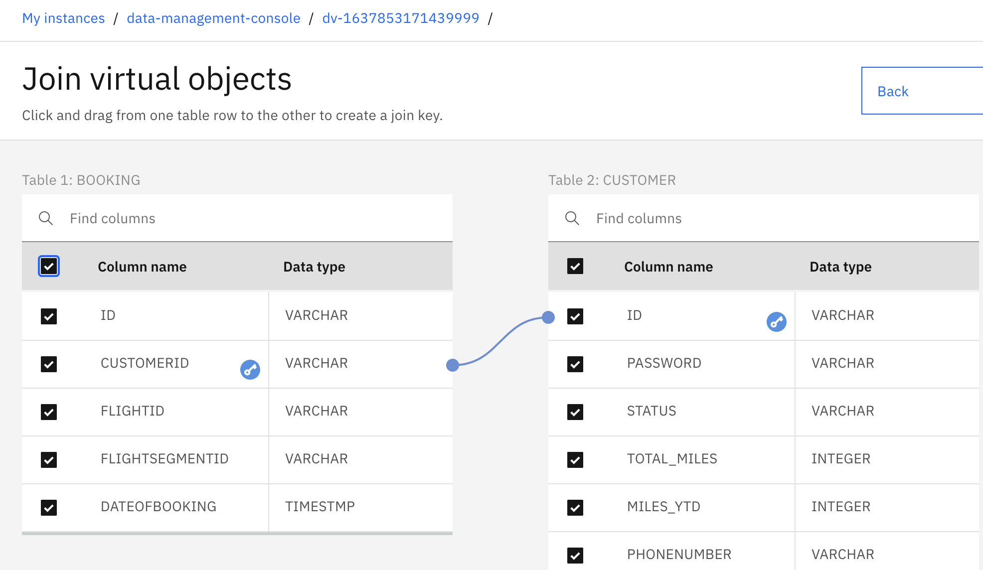
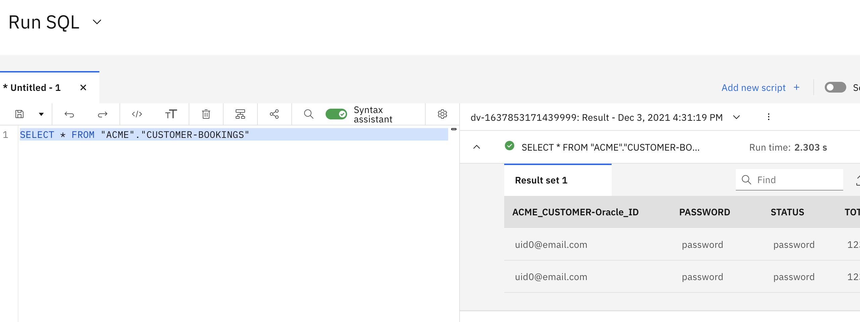
RetailOne Demo

Slide 8
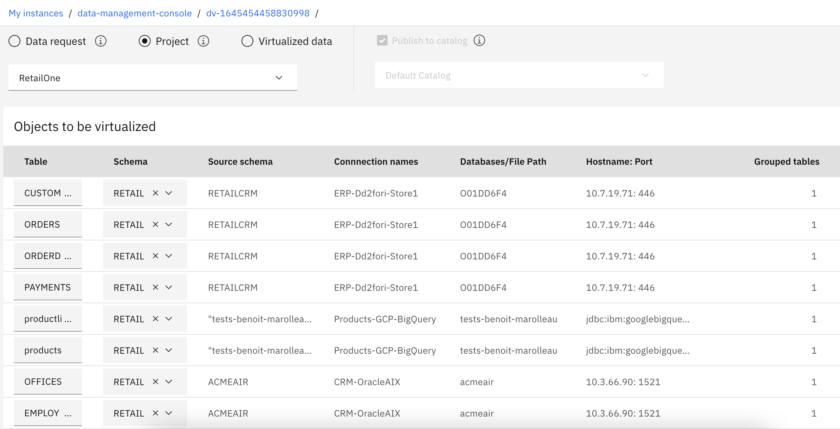
RetailOne Demo

Slide 9
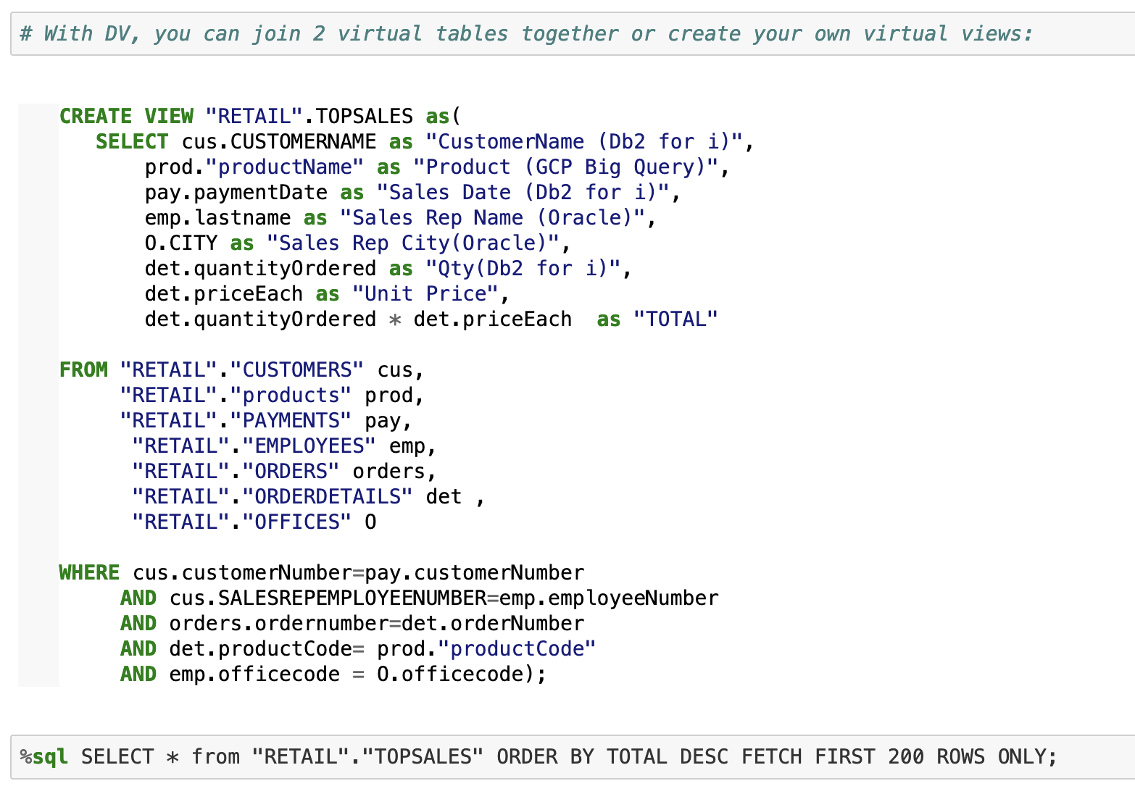
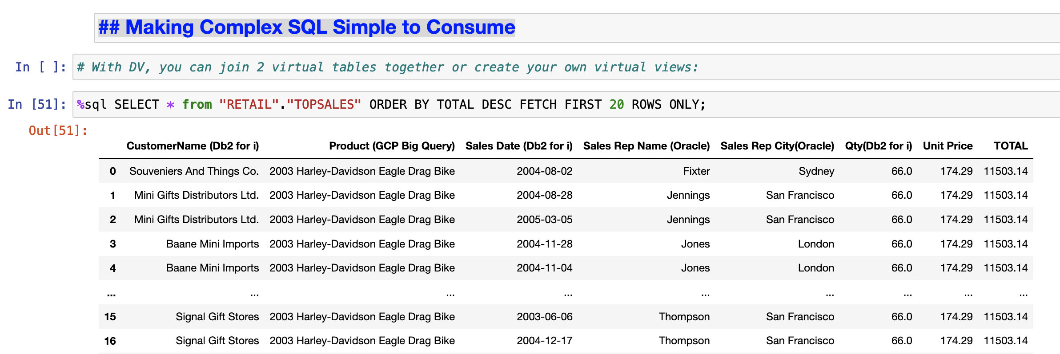
RetailOne Demo
Example: How can I get my Top 200 Sales
from multiple data sources in one simple query ?
Simplified & secured access
to business data
Virtual Views pointing to multiple dispersed joined databases
Up to date data (no data copy)
Reenforced Data Governance: Catalog, Masking, Access Management

Slide 10
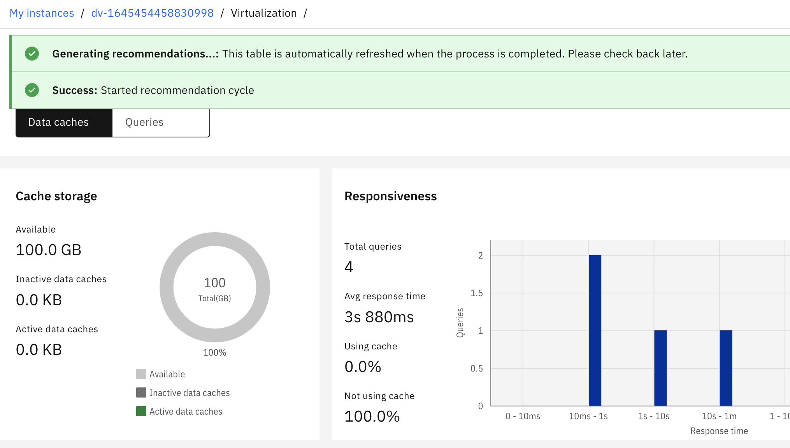
RetailOne Demo

Slide 11
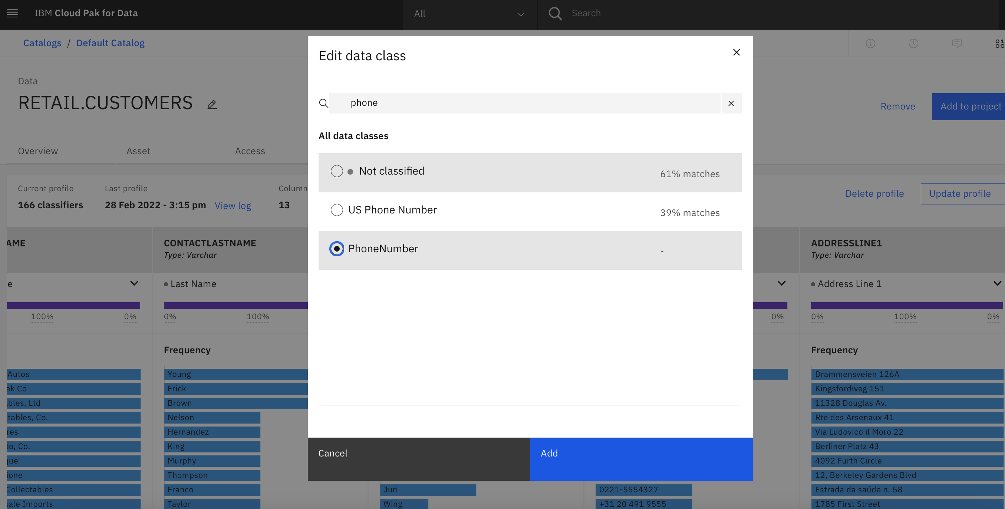
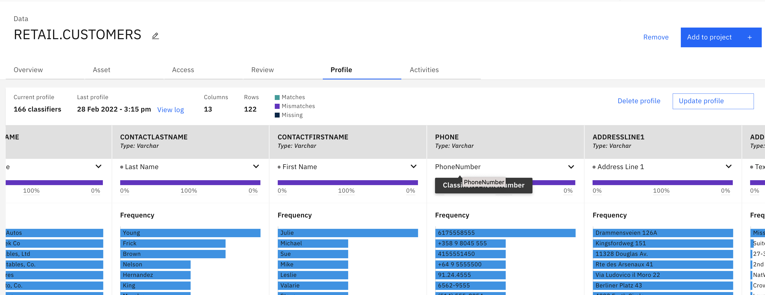
RetailOne Demo

Slide 12
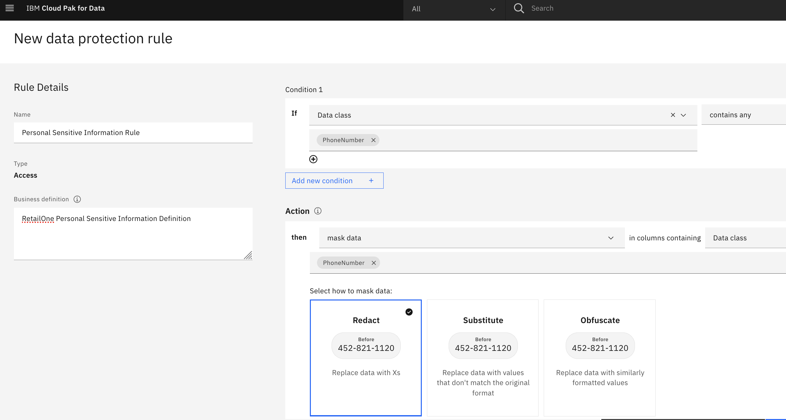
RetailOne Demo

Slide 13
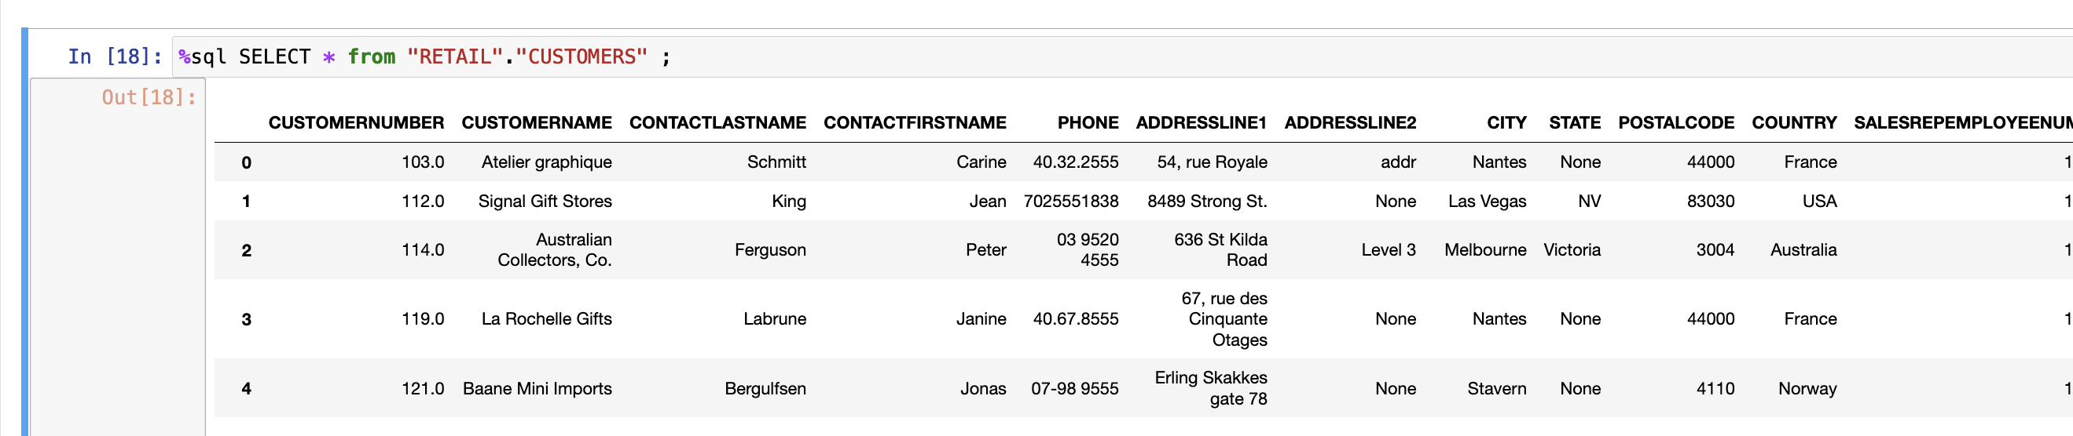
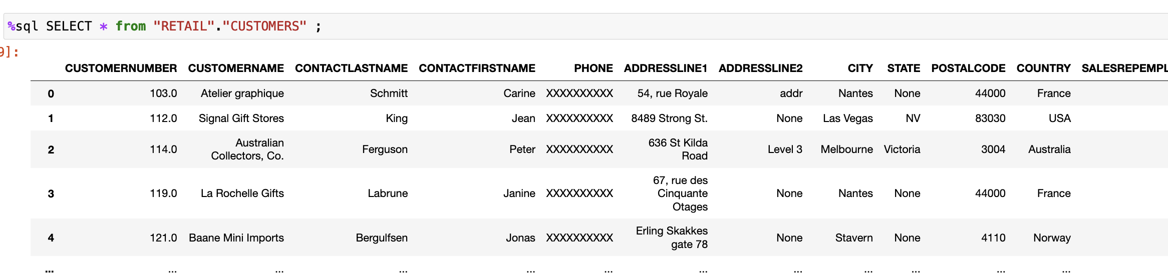
RetailOne Demo

Slide 14
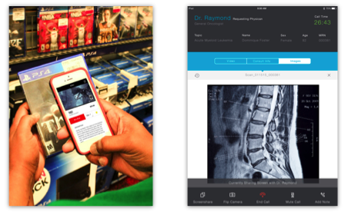
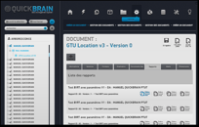
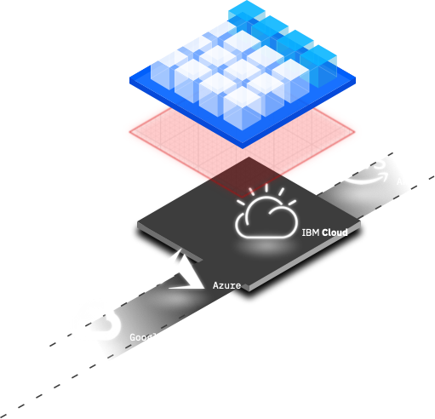


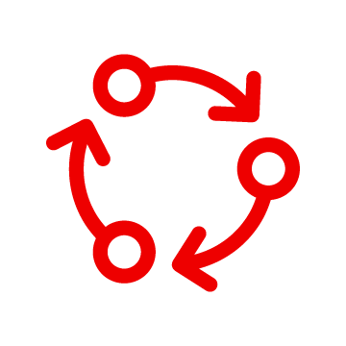

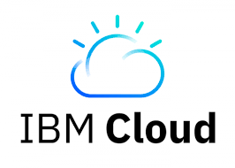


Hybrid Cloud Solutions
Retail / Banking use case
Data Platform Modernization
Data Compliance
Customer Data Management
AIOps
Multi-Cloud Management
Business Continuity
ANY DATA, ANY CLOUD, ANYWHERE IBMs data fabric based on IBM Cloud Pak for Data
Data Gate
Core Business
IBM Cloud Paks
Core Business
IBM Cloud Paks
Red Hat OpenShift
Red Hat OpenShift
Red Hat OpenShift Container Storage
Secure link
Red Hat OpenShift Container Storage
RHACM
On Premise - Private Cloud
Red Hat OpenShift
Hub Cluster
Cluster Lifecycle – App Lifecycle – Observability – Governance/Risk

Slide 15
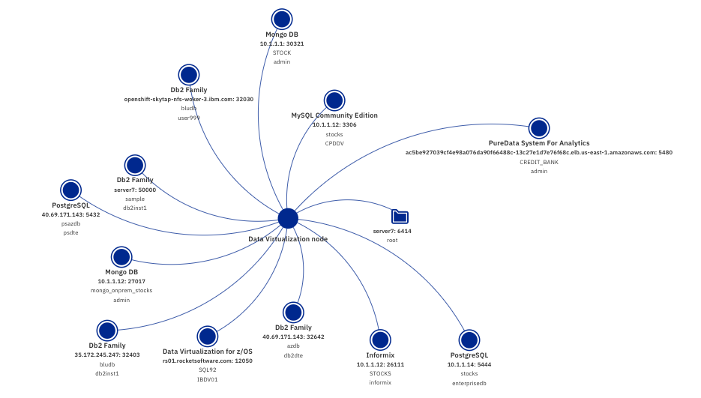
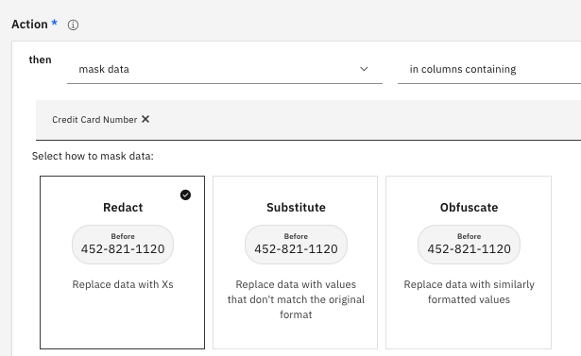
Extend and Standardize your Data Estate
Connect heterogeneous data sources
Join data using advanced SQL
Create views to simplify access
Protect data with deep data governance
Accelerate performance with local caching
Connect with your existing tools
Build like a Data Scientist with Watson Studio
Access through RESTful services and endpoints
Notes:
You can combine your PostgreSQL data with data from numerous other sources. It is easy to connect to each data source using pre-packaged drivers for many data sources. You can also add your own drivers and connect to flat file data sources.

Slide 16
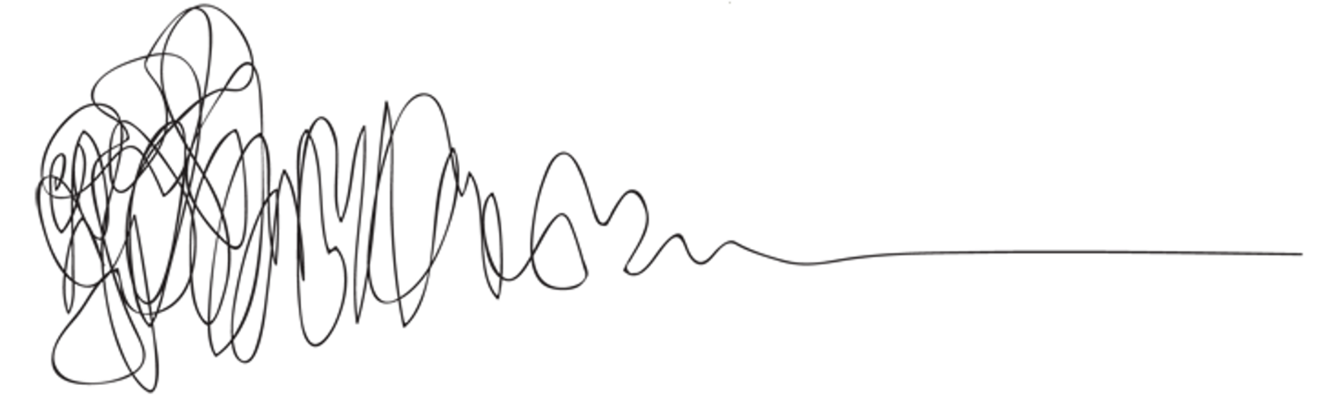
Why is it harder than it looks?
Data is in multiple hetrogeneous data servers
Data servers are running on premises…
…and on multiple cloud providers
Data is maintained by different teams
Data governance is mandatory
Replicated data is always old data
Notes:
The problems is that the data is spread out across systems, platforms, owners, and time. And it is expensive, time consuming, and risky to move the data. Moving data means it is always out of date.

Slide 17
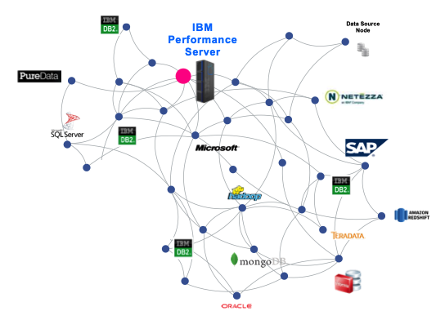
You can make this
Notes:
You can reduce the complexity of your data estate

Slide 18
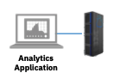
Look like this
Notes:
And make everything appear like it is in a single database, without having to build and populate a physical warehouse.

Slide 19
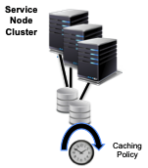
With this
IBM Cloud Pak for Data
Data Virtualization
Notes:
IBM Data Virtualization can dramatically simplify you data estate.

Slide 20
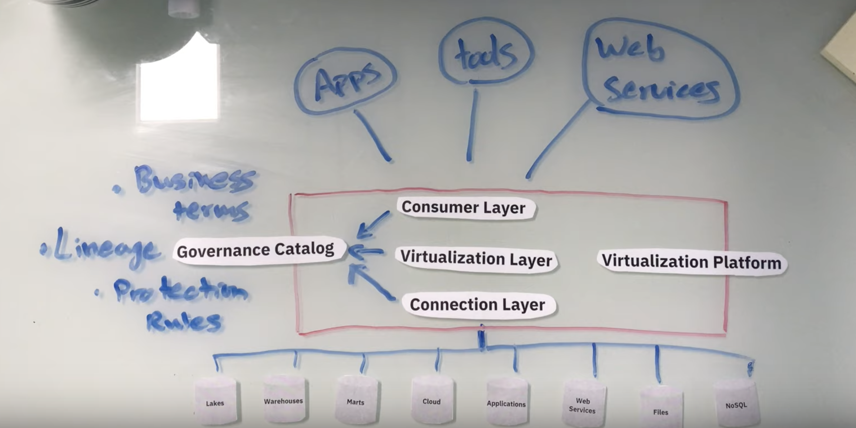
Data Virtualization

Slide 21
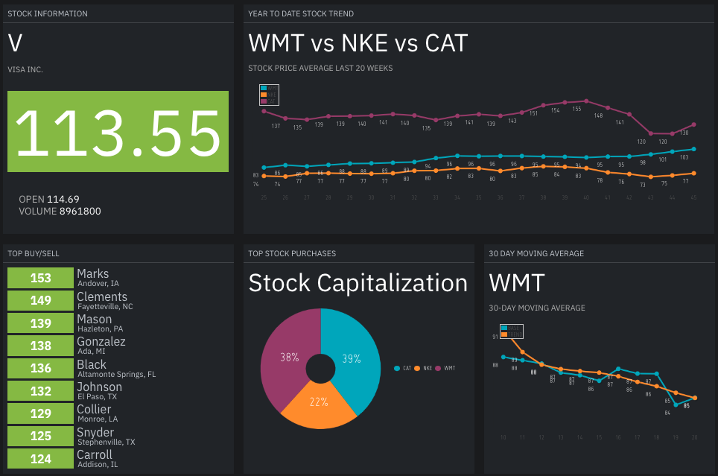
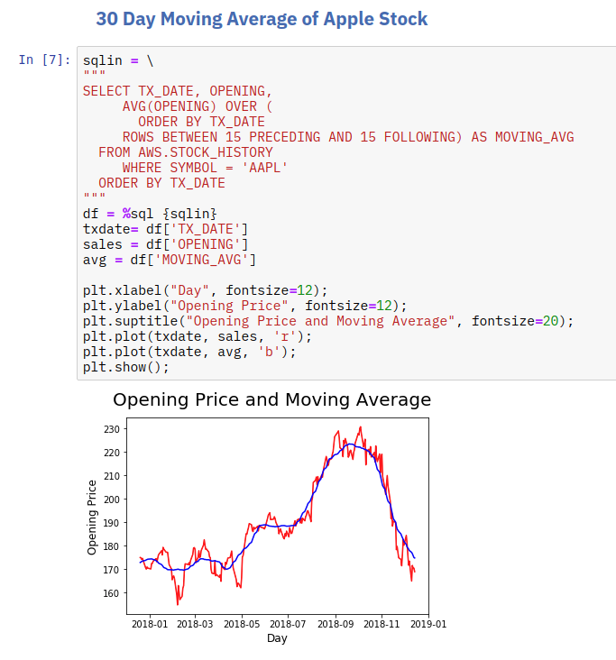
All your Data Analysis from one Data Source
One connection for simplicity and performance
THIS DEMO IS RUNNING ON REAL MULTI-CLOUD, HETROGENEOUS, DISTRIBUTED LIVE DATA
Notes:
You can demonstrate how easy it is to build an application that combines data from multiple data sources. Any IBMer can provision their own demonstration cluster in minutes. Using the DTE cluster you can be up and running with a preconfigured system. You can easily demonstrate how easy it is to combine data from multiple sources. The end user, analyst or data scientist feels like they just need to connect to a single database.

Slide 22
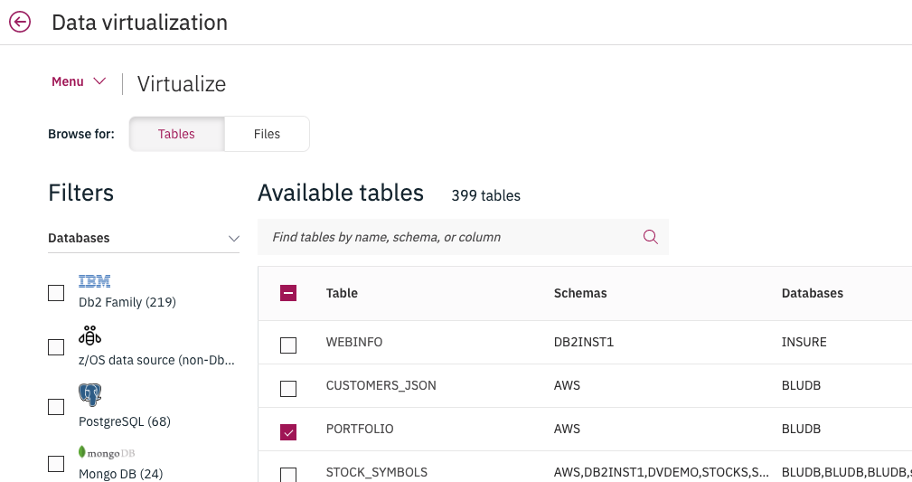
Virtualize Data
Make a remote table work like a local table without moving data
Notes:
Now that you can see that we have connections to all the key data sources in the Acme enterprise, you can start to create virtual connections to individual tables. The key message is that you can make remote data look, act and feel like a local table.

Slide 23
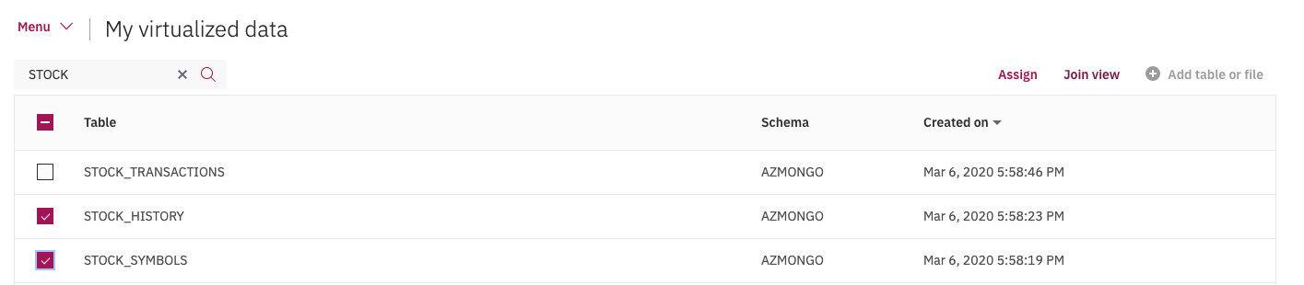
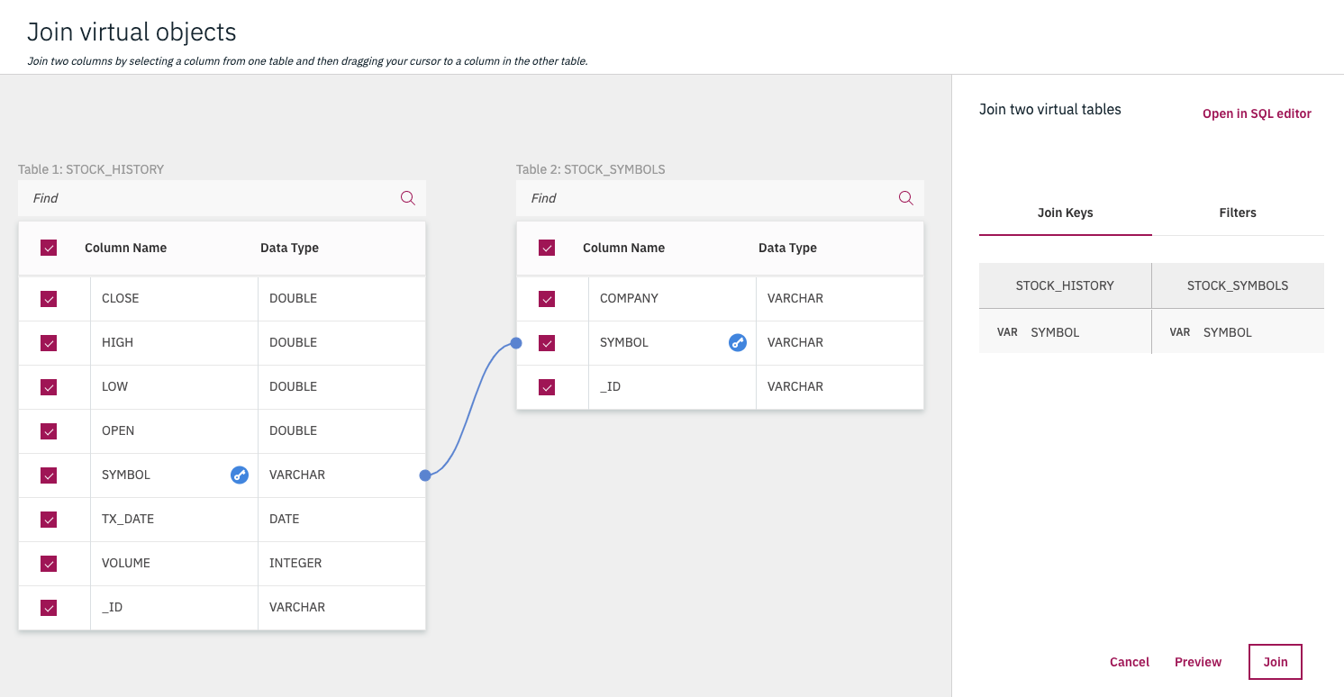
Join virtual tables
Make two virtual tables work like a single local table
Notes:
You can also join data from tables that are not the same. You can join data across to tables, which can be from different data sources, by selecting the tables, selecting Join View and then click connecting two rows. Select Join or Preview to join the tables together. Under the covers this creates a view that look and acts like a new local table.

Slide 24
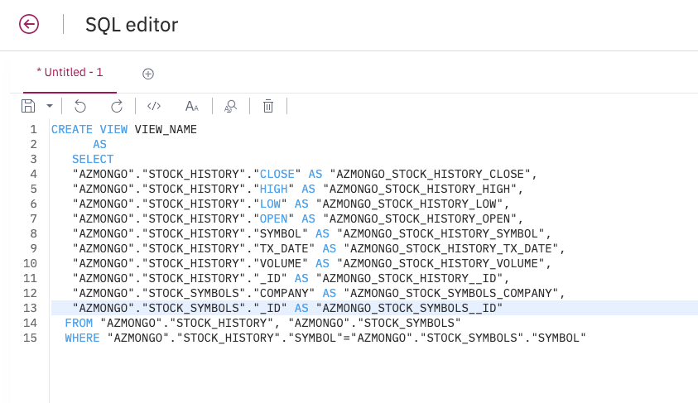
SQL editor
Build Views from Complex Queries
Design your own queries so they work like a local table
Notes:
If your queries are more complex than a simple join you can use the SQL editor to create custom views across virtualize data and even capture the query in a permanent view. The new view will act like a new local table.

Slide 25
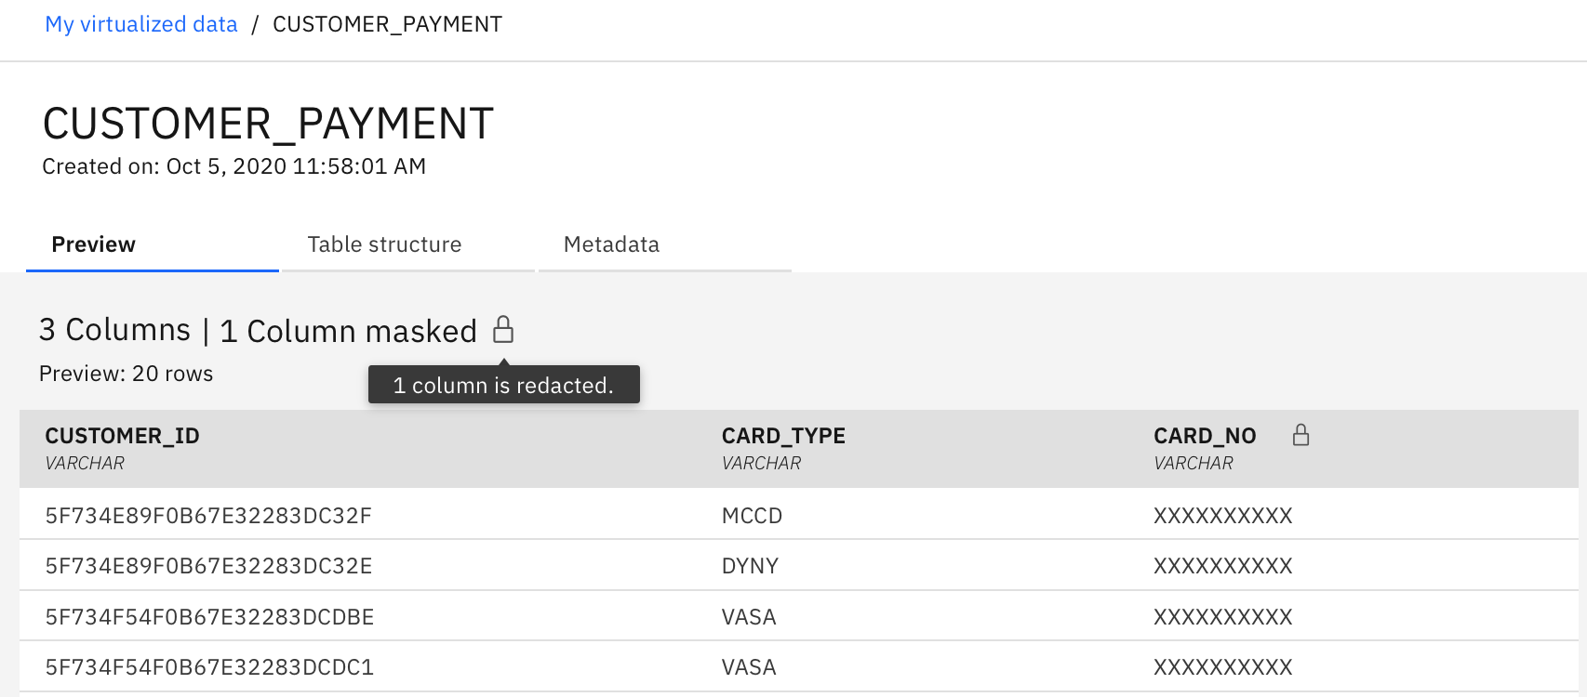
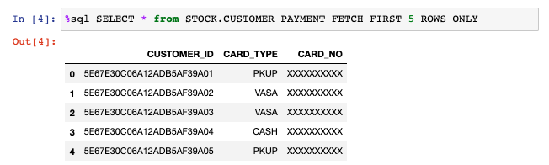
Protect Data using Deep Data Governance
Classify data and protect using active masking
Notes:
Use the connection between Data Virtualization and Watson Knowledge Catalog to classify and protect classified data by redacting results in Cloud Pak for Data or external applications.

Slide 26
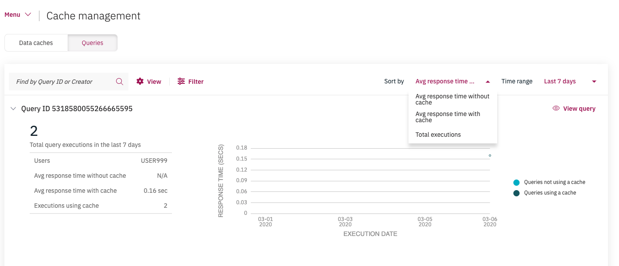
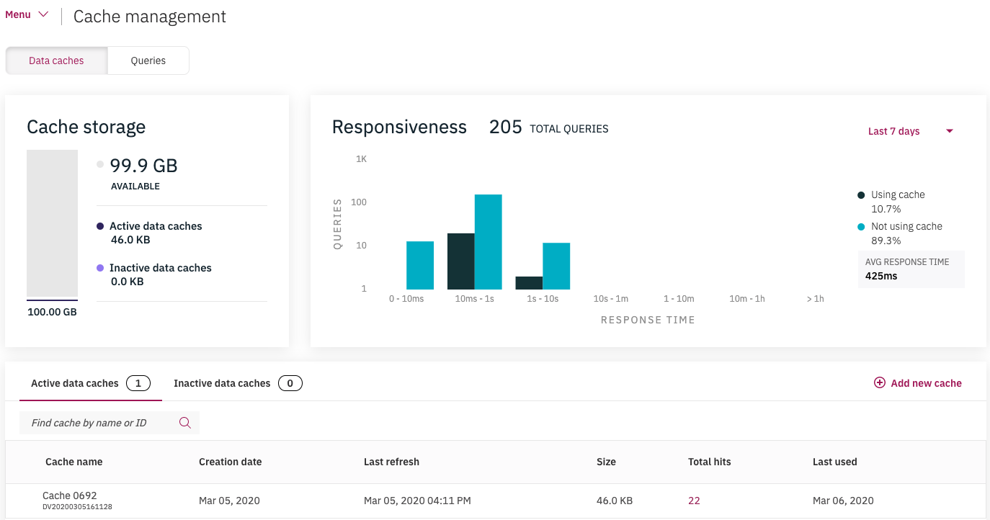
Optimize Performance
Cache results for optimum performance
Notes:
But how do you ensure this goes fast? Caches let you review your most time and resource consuming queries and cache the results to ensure top performance.

Slide 27
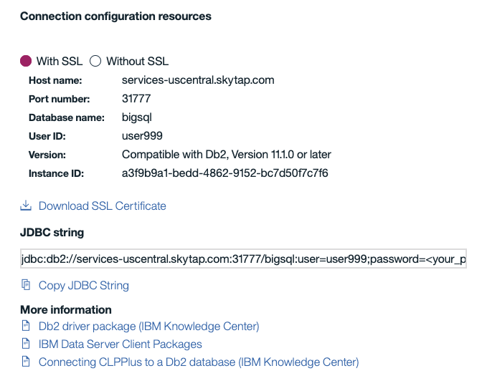
Connect your Analytics Applications
Notes:
Now that all the data, and queries you want to access are available through virtual tables and views you can connect an external application by using the Connection details information.

Slide 28
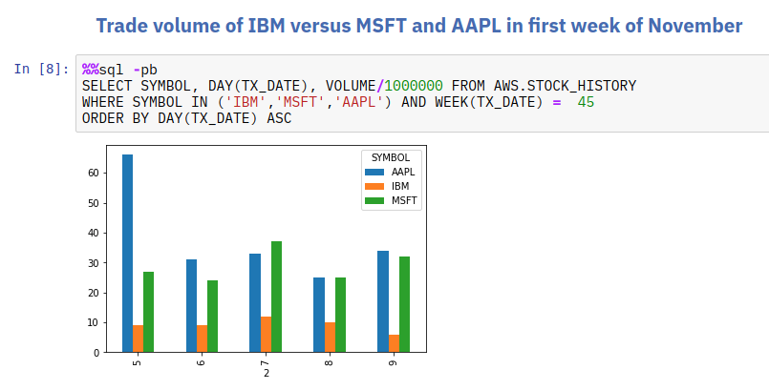
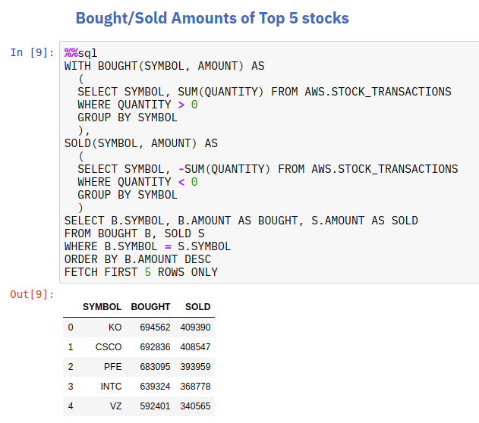
Connect with Jupyter Hub
Use advanced Data Scientist Tools
Notes:
Demonstrate how you can easily create reports and do advanced Data Science analysis easily because for the end user it feels like they just need to connect to a single database. Don’t show the how, just demonstrate that this is working and stress that this is live code running across real, not simulated, multi-cloud environment. We should introduce this and deal the details to a HOL

Slide 29
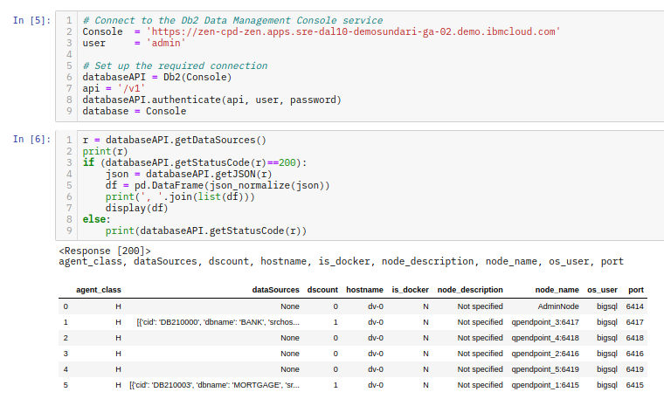
Connect with REST to Manage Data Virtualization
Use advanced Microservices
Notes:
The Cloud Pak for Data platform is a true microservices environment. You can access the data virtualization engine using RESTful APIs that give you access to the same information that is available through the UI. You can browse virtualized data, data sources, run SQL and interact with the Data Virtualization engine with a host of other APIs. We should just introduce this an leave the detail to a HOL.

Slide 30
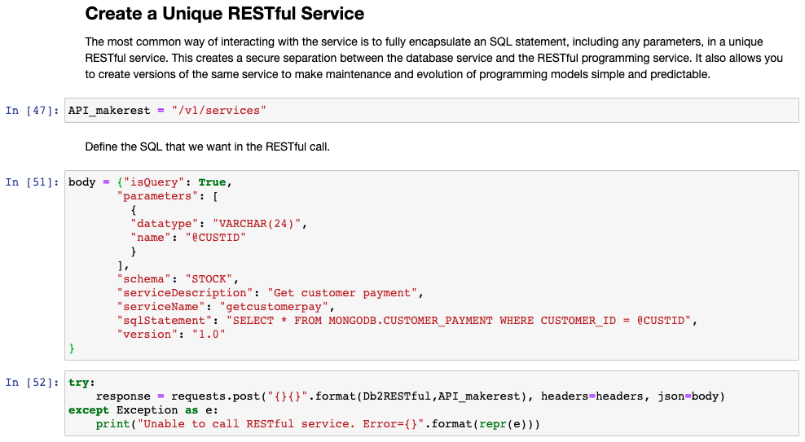
Connect applications to RESTful Endpoints
Preview of the Db2 Endpoint Service
Notes:
You can also preview how to use the Db2 RESTful Endpoint Service with Data Virtualization. You can create unique RESTful services and control who can access those services. The most common way of interacting with the service is to fully encapsulate an SQL statement, including any parameters, in a unique RESTful service. This creates a secure separation between the database service and the RESTful programming service. It also allows you to create versions of the same service to make maintenance and evolution of programming models simple and predictable.

Slide 31
Backup Slides

Slide 32
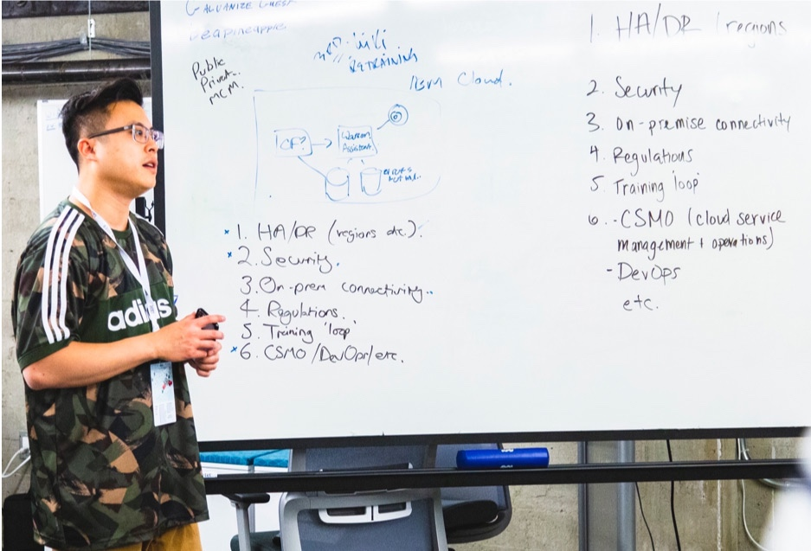
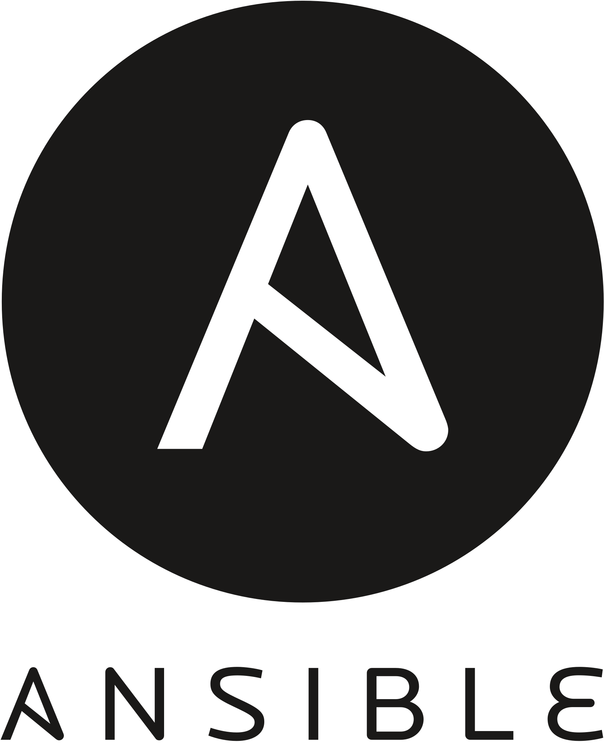
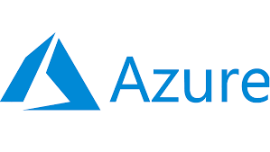







Hybrid Cloud @ IBM Systems Center - Montpellier
January - Cloud Community
Agenda
Intro / Welcome
MOP Network Hybrid Cloud status (AWS, IBM , ...) Hervé Rey - 5 minutes
Available Infrastructure in 2022 Jerome Farenq - 5 minutes
CP4D/Data Fabric - Intro, Activities, Data virtualization Benoit Marolleau - 5 minutes
Ansible Tower for Health Check & compliance Charlotte Despres/Francis Cougard - 15 minutes
AIOps intro, solutions, contacts, Tech Zone Power Demo Gauthier Siri - 20 minutes
Q&A / Call for Contributors / Interactions (cross dpt) Speakers, who’s next?
10 AM - Friday, January 14th https://ibm.webex.com/meet/benoit.marolleau
Support IBM Hybrid Cloud strategy with Systems capabilities

Slide 33


Slide 34









Data Modernization and Transformation
Data modernization: Key drivers
Digital enablement, unlocking the data or cost optimization – always involved resolving data issues
Data issues have significant impact on scaling of any solution
A structured data modernization approach follows identifying the right data transformation / restructuring approach for the right use case
Deep understanding of the data is key to successful optimization of data
Transform & Optimize for digital consumption
Data integration to build co-existence layers for driving hybrid modernization
Significant performance issues, data retention policies etc (structure, quality etc,)
Modernization of application and database for agility and better supportability, lower risk
High database MIPS driving overall costs
Key Approaches
Traditional
Event based replication of data for read only / insights
Hybrid Cloud
Modernization Discovery Model built with technology agnostic mapping models
Other 3rd party traditional databases
Upgrade, Optimize, Re-structure database
Object Storage
Key data modernization services
Database Migration
Database Upgrade & Optimization
Data Delivery Optimization
Data Structure Modernization
Data Security

Slide 35
Hybrid Data Modernization Patterns
Pattern | Description
Refactor | Re-architect and restructure existing data architecture leveraging a mix of new and existing data stores. Can include revised database type, DB schema, data model, etc. Simplest form of refactor would split up existing databases without changing the schema
Enrich | Combine new data sources with existing data to deliver advanced business value using BI, ML, and AI
Re-platform | Migrate database to new target. Make minimal changes to schema to adapt to the new platform, but do not change the structure or the features or functions it provides
Containerize | Move a database into a container-based version of the same database technology (with a minimal amount of application change)
Externalize | Provide API access to existing data, while preserving current single-source of truth
Migrate | Lift and shift database to a cloud environment without changing underlying DB technology (typically only used as an interim solution for modernization candidates), including changing encryption scheme
Replicate | Copy data to another availability zone for backup, to different regions for disaster recovery, to cache to optimize application access
Retain | Do nothing (could be left as is for one-to-many modernization increments or as a final disposition)

